Slide 1
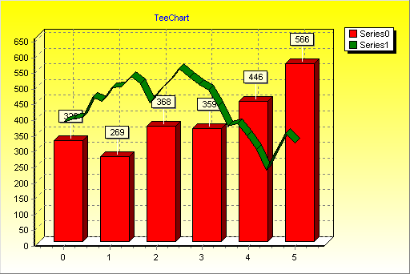
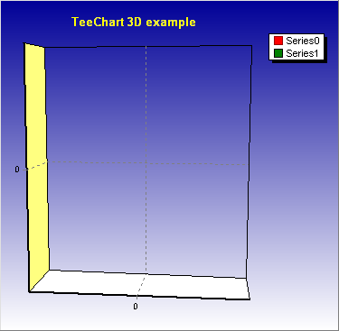
TeeChart presentation example
Chart as inserted object
Chart as inserted control
The Left Chart is inserted as an object on the
page. It may be Edited at design time and acts
as a static image at run (display) time.
The Right Chart is inserted as a Control on the
page using the VBA toolbars. It may be Edited at design time and be acted upon by code at runtime (See the animation button).

